Slide 1
Prediction Using Regression, XGBoost, LSTM, ANN & ARIMA
A hands-on coding activity for time series forecasting

Slide 2
Objective
Use different statistical, machine learning and deep learning models to predict future values in a time series dataset.

Slide 3
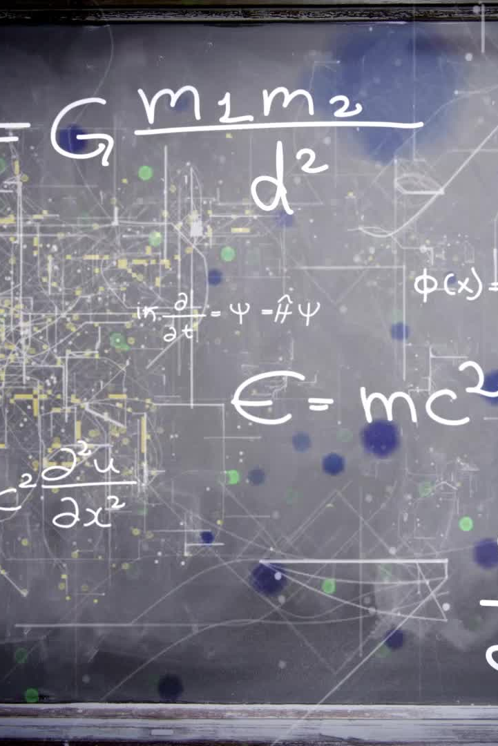
Models Covered
Linear Regression
XGBoost
LSTM (Deep Learning)
Artificial Neural Network (ANN)
ARIMA (Statistical Time Series Model)

Slide 4

Dataset Used
Example: Airline Passenger Dataset (Monthly data of passengers over time https://github.com/jbrownlee/Datasets )
Source: https://raw.githubusercontent.com/jbrownlee/Datasets/master/airline-passengers.csv

Slide 5
Steps in the Activity
1. Load and Explore Data
2. Preprocess Data
3. Train-Test Split
4. Model Training & Evaluation
5. Compare Model Performance

Slide 6
Step 1: Load Data
Load time series dataset and visualize trends.
Example Code:
```python
import pandas as pd
import matplotlib.pyplot as plt
url = 'https://raw.githubusercontent.com/jbrownlee/Datasets/master/airline-passengers.csv'
df = pd.read_csv(url, parse_dates=['Month'], index_col='Month')
plt.plot(df)
plt.show()
```

Slide 7
Step 2: Preprocessing Data
Convert data into supervised format, scale values for deep learning models, and handle missing values.

Slide 8
Step 3: Linear Regression Model
Train and predict using Linear Regression.
Example Code:
```python
from sklearn.linear_model import LinearRegression
lr = LinearRegression()
lr.fit(X_train, y_train)
y_pred_lr = lr.predict(X_test)
```

Slide 9
Step 4: XGBoost Model
Train and predict using XGBoost.
Example Code:
```python
import xgboost as xgb
xgb_model = xgb.XGBRegressor(objective='reg:squarederror')
xgb_model.fit(X_train, y_train)
y_pred_xgb = xgb_model.predict(X_test)
```

Slide 10
Step 5: LSTM Model (Deep Learning)
Train and predict using LSTM neural networks.
Example Code:
```python
from tensorflow.keras.models import Sequential
from tensorflow.keras.layers import LSTM, Dense
model = Sequential([
LSTM(50, activation='relu', return_sequences=True, input_shape=(1,1)),
LSTM(50, activation='relu'),
Dense(1)
])
```

Slide 11
Step 6: ANN Model (Deep Learning)
Train and predict using Artificial Neural Networks (ANN).
Example Code:
```python
from tensorflow.keras.models import Sequential
from tensorflow.keras.layers import Dense
ann_model = Sequential([
Dense(64, activation='relu', input_shape=(1,)),
Dense(32, activation='relu'),
Dense(1)
])
```

Slide 12
Step 7: ARIMA Model
Train and predict using ARIMA for time series forecasting.
Example Code:
```python
from statsmodels.tsa.arima.model import ARIMA
arima_model = ARIMA(train['Passengers'], order=(5,1,0))
arima_model_fit = arima_model.fit()
y_pred_arima = arima_model_fit.forecast(steps=len(test))
```

Slide 13
Step 8: Model Evaluation
Evaluate models using Mean Absolute Error (MAE), Mean Squared Error (MSE), and R2 Score.
Example Code:
```python
from sklearn.metrics import mean_absolute_error
mae = mean_absolute_error(y_test, y_pred_lr)
```

Slide 14
Results & Comparison
- Compare models based on performance metrics.
- Plot predictions vs actual values.
- Identify the best model for time series forecasting.

